Slide 1

Contributory Market Insights Alerts
Fido Analytics

Slide 2
Agenda
Alerts types
Alerts level
Impact of Covid-19
Zero values
Alerts implementation
Fido Analytics

Slide 3
Alerts Types
8 Alerts in total
Two types of alerts(high value alerts and low value alerts) in 4 categories:
Category | Calculation | Alerts Type | Alerts Type
Closed counts | claim_paid_closed_count_window | Low closed counts | High closed counts
Reported counts | claim_reported_count_window | Low reported counts | High reported counts
Severity | paid_closed_claim_amount_window / claim_paid_closed_count_window | Low severity | High severity
Reported Frequency | claim_reported_count_window/earned exposure | Low frequency | High frequency
Fido Analytics

Slide 4
Alerts Level
Monthly Alerts
Based on past 5 months trend
On the level of coverage_type_sk, policy_state_sk, window_sk,shopgroup_sk, groupname
Category | Calculation | Alerts Type | Alerts Type
Closed counts | claim_paid_closed_count_window | Low closed counts | High closed counts
Reported counts | claim_reported_count_window | Low reported counts | High reported counts
Severity | paid_closed_claim_amount_window / claim_paid_closed_count_window | Low severity | High severity
Reported Frequency | claim_reported_count_window/earned exposure | Low frequency | High frequency
Fido Analytics

Slide 5
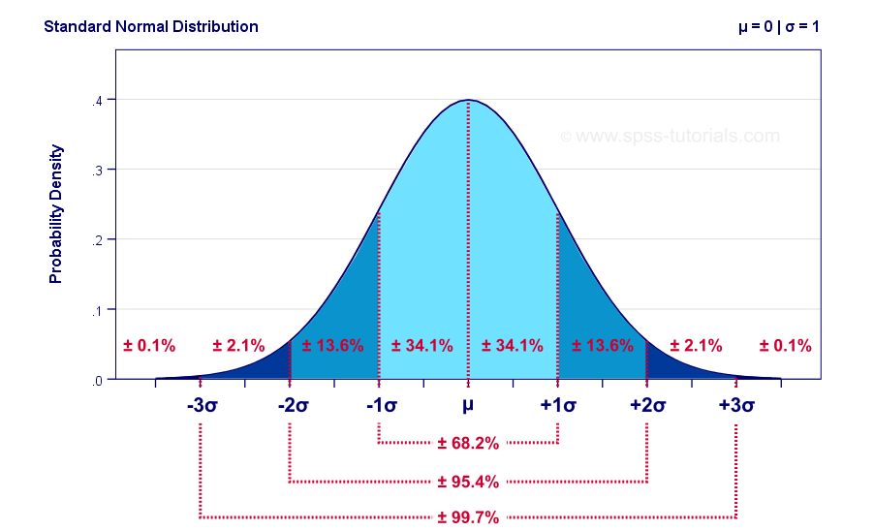
How to calculate alerts?
Months are rolling
Based on past 5 months trend, for each claim group by
coverage_type_sk, policy_state_sk, window_sk,shopgroup_sk, groupname
Current Month | Prior-1_month | Prior-2_month | Prior-3_month | Prior-4_month | Prior-5_month
Sep-2020 | Aug-2020 | Jul-2020 | Jun-2020 | May-2020 | Apr-2020
μ: past 5 months average
σ : past 5 months standard deviation
Set lower-bound: μ - 5 σ
Current month values < lower-bound is considered as low values
Set upper-bound : μ + 5 σ
Current month values > upper-bound are considered as high values

Slide 6
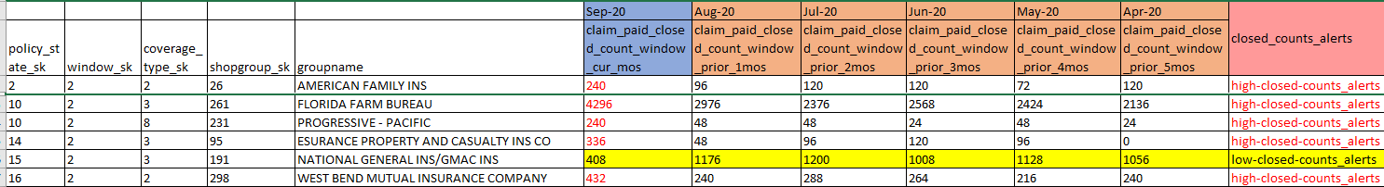
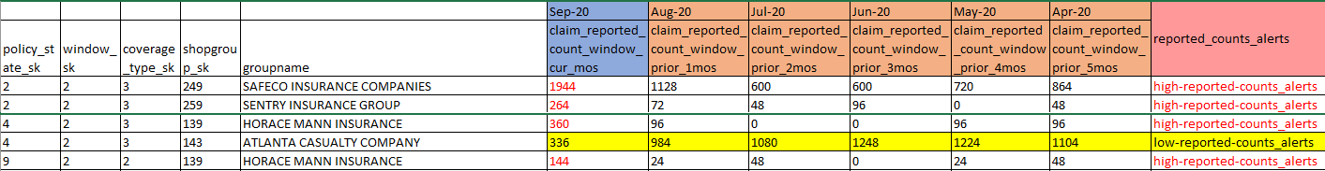
Looking into alerts
Should below closed_counts receive alerts?
Should below reported_counts receive alerts?
Fido Analytics

Slide 7

Alerts Advantages
Wide coverage
Detect both extremely low & high values
High accuracy
Every claim is different
Find the anomalies for each claim based on its past trend
Less impacted by seasonality
Months are rolling, thus the trend is moving forward every month

Slide 8
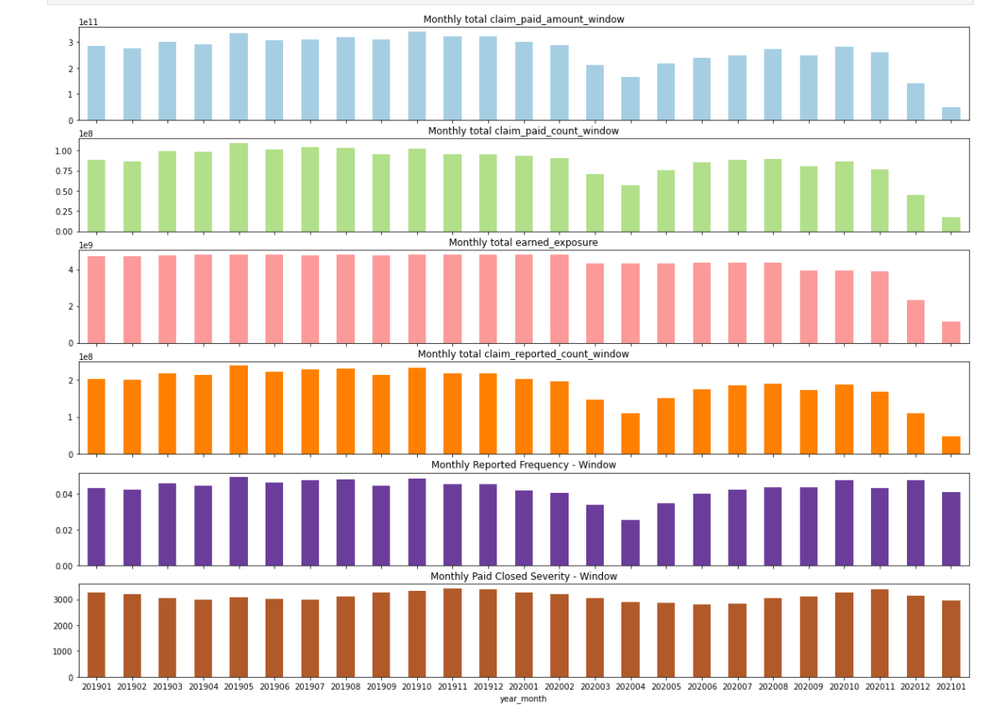
Impact of Covid-19
APR 2020
The data is heavily impacted by Covid-19, thus need to treat the data from Apr-2020 to Sep-2020 separately

Slide 9
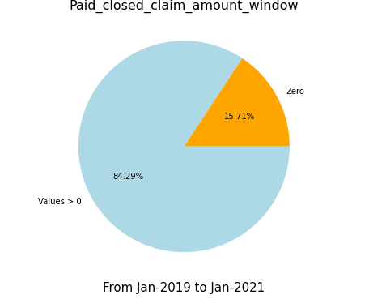
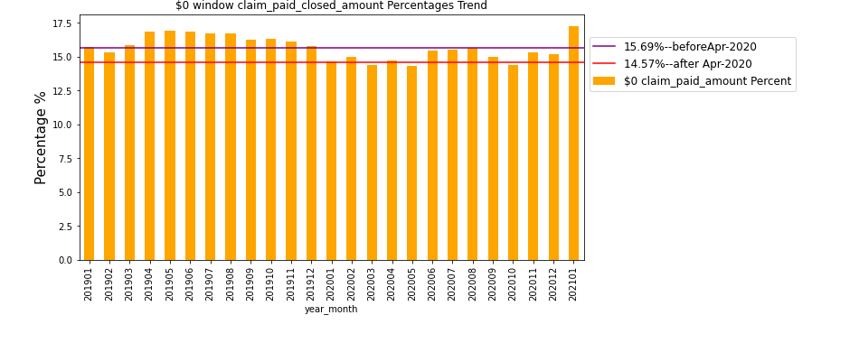
Zero Values
Fido Analytics

Slide 10
What’s next?
Engineering implementation
Fido Analytics

Slide 11
Thank you!
Fido Analytics

